Slide 1
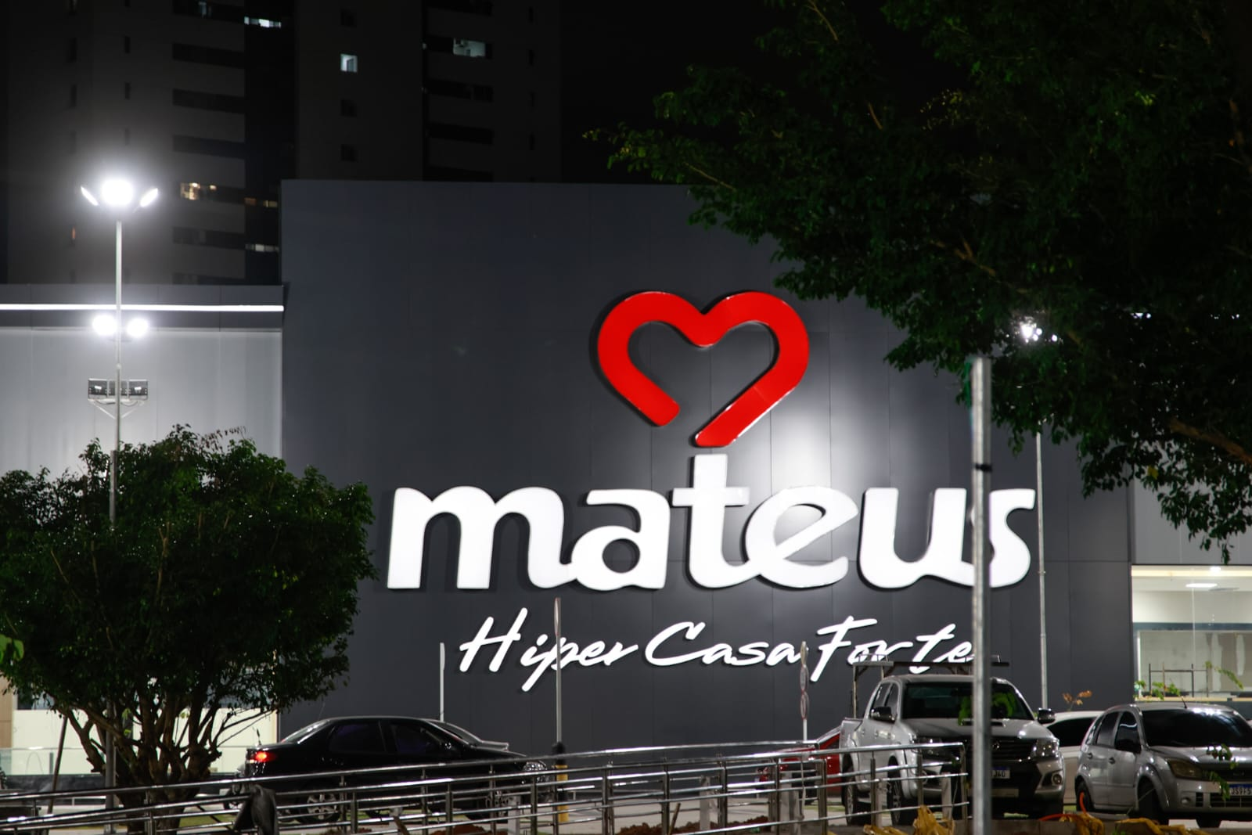
Business Analysis & Investment Thesis
Grupo Mateus
Case Study Presentation – Yalla Capital
August 25, 2025
Recommendation: BUY
Our analysis is supported by a DCF and Comps analysis indicating a 34% upside on the base case, currently undervalued by the market.

Slide 2
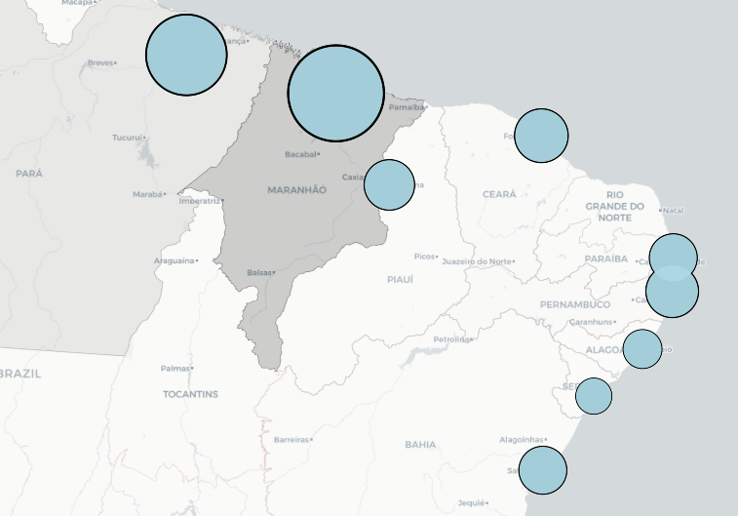
Company Overview
Founded in 1986 and headquartered in São Luís, Grupo Mateus is a brazilian food retail company focused in the northeast and north. The company operates across various segments, including traditional retail, cash-and-carry, and electronics, demonstrating its ability to adapt and expand to meet the needs of a diverse consumer base. This multichannel approach has been a key driver of the company's success, allowing it to penetrate new markets and solidify its operation.
Integrated Distribution Ecosystem: The company's logistics network, supported by 18 distribution centers and a large fleet of trucks, creates a significant barrier for competitors to entry in the region.
Financial Strength: Solid financial position, with low levels of debt compared to its peers, allows it to sustain its investment cycle and working capital, even with higher interest rates.
Multichannel Model: Its diverse store formats serve to a wide consumer base and provide a competitive edge in a consolidating market.
70
Total Stores: 279
138
14
*2025 with estimated numbers (+25)
11
9
13
4
3
9

Slide 3
Market Overview: Food Retail Sector in Brazil
Cash & Carry format remains the primary growth driver:
This trend reflects a continued consumer preference for value, especially in a challenging macroeconomic environment.
The segment's strong performance is a key indicator for players with significant exposure, like Grupo Mateus.
Headwinds in the Consumer Durables segment:
The electronics category is facing a sector-wide slowdown, impacted by reduced consumer credit and macroeconomic pressure.
This has led companies to optimize their portfolio by closing underperforming stores.
Grupo Mateus is positioned for aggressive organic expansions:
With a healthier balance sheet and a well-established distribution network, Grupo Mateus is uniquely positioned to continue its organic expansion and route densification strategy, particularly in the Northeast region.
Premium Valuation Reflects Superior Growth:
Grupo Mateus exhibits a significantly higher revenue growth forecast (15.5% CAGR) compared to the peer median (4.6%).
The market acknowledges this potential, assigning a premium valuation multiple to the company (6.3x EV/EBITDA vs. 5.8x peer median)

Slide 4
Benchmarking Grupo Mateus to Public Food & Staples Retail Peers
Operating Metrics
CY’25LTM – CY’27E
Revenue
CAGR
1st Quartile: 3.4%
Median: 4.6%
3rd Quartile: 5.5%
CY’26E
EBITDA
Margin
1st Quartile: 7.7%
Median: 9.1%
3rd Quartile: 10.1%
Valuation Metrics
CY’26E
EV / EBITDA
1st Quartile: 5.1x
Median: 5.8x
3rd Quartile: 7.1x
CY’26E
P / E Ratio
1st Quartile: 11.1x
Median: 12.0x
3rd Quartile: 16.9x
Source: S&P Capital IQ consensus estimates as of 8/22/2025. Note: Median and quartile metrics exclude Grupo Mateus. Brazil does not have a large number of retail comparable companies, so other latin american firms were used as a peer group. Grupo Mateus valuation is based on unafected share price of R$ 6.78, also as of 8/22/2025.

Slide 5



Discounted Cash Flow Analysis – With a conservative revenue CAGR of 12.1%, Grupo Mateus is undervalued in the base case
(R$ in millions)
Key assumptions
Margin Maintenance: While 40% EBITDA margins are not expected in the retail sector, Grupo Mateus' profitability is very healthy with 7.5% LTM EBITDA margin, which is good compared to 6.9% median of peers. We also project a 30bps annual margin expansion driven by economies of scale.
Store Expansion: Management is projecting 50 new stores per year, which we use for our bull case (this seems unrealistic in the current economic environment). Our base case projects a more conservative 25 new stores annually, with a 1% increase in revenue per store.
Working Capital: As a key driver for a retail company, we project an improvement in working capital management, with net working capital as a percentage of revenue decreasing from 20% in 2024 to 16% by 2030.
CapEx: To support the store expansion, we maintained an annual CapEx around 1.1 billion. This is consistent with the company's historical average of 1.07 billion to open 30 stores per year since 2020 and aligns with our base case projection of 25 new stores.
EV / EBITDA Multiple
Gross Margin (2030E)
EBITDA Margin (2030E)
WACC
Upside / (Downside)
5.8x
22.9%
9.1%
11.7%
(7.7%)
5.8x
23.3%
9.7%
11.7%
34.0%
5.8x
23.7%
10.3%
11.7%
94.8%
Source: S&P Capital IQ for financials as of 8/22/2025.

Slide 6
Investment Pros and Cons: SWOT Analysis
Strengths:
The company has demonstrated exceptional execution capabilities, achieving a historical revenue CAGR of 26.84% from 2020 to 2024.
A healthy balance sheet, stronger than its main peers, allows the company to sustain its expansion.
A robust logistics and distribution network in the North/Northeast region creates a competitive advantage.
Weaknesses:
Market is projecting an EBITDA margin below its peer median for 2026.
The Consumer Durables (Electronics) segment consistently underperforms, but the company is focusing its investments in the other segments.
Opportunities:
Our DCF analysis indicates a 34% upside to the current share price, suggesting the market has not fully priced in the company's long-term growth potential.
With a strong presence concentrated in Maranhão and Pará, there is a long space for expansion to other underserved states in the Northeast.
Threats:
The high interest rate environment in Brazil directly impacts consumer credit, which is a significant risk to its segments.
The founding family holds a majority stake of over 68%, giving them significant influence over strategic decisions, which is a risk for minority shareholders.

Slide 7
Investment Recommendation: BUY (R$ Millions, except share price)
Retail
The Brazilian food retail sector is extremely difficult. However, a deep dive into the financials we can see a clear and significant investment opportunity here.
Growth
Our analysis indicates a long runway for growth. The company's strategic focus on organic expansion, coupled with the maturation of its existing store base, is expected to drive significant revenue growth and margin expansion.
Upside
Our DCF valuation, supported by a perpetuity growth cross-check, suggests a price target of R$ 9.09, representing a 34% upside. This valuation remains attractive even with more conservative assumptions, as demonstrated by our sensitivity analysis.
Source: S&P Capital IQ for financials as of 8/22/2025.

